Slide 1
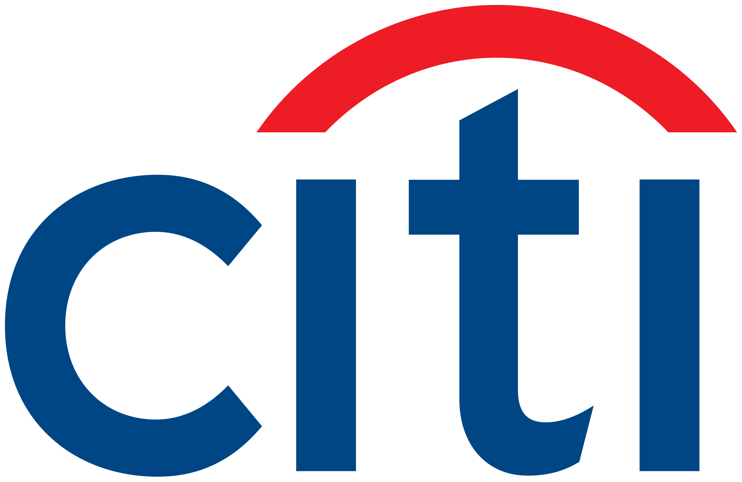
Investment Strategy Meeting
Prepared for Alex
05/03/2025

Slide 2
Agenda
Introduction
Asset Allocation
Investment Selection
Risk Management
Next Steps
Questions

Slide 3
Financial Goals
Long-term Growth: Aim to significantly grow wealth over the next 2—30 years to secure comfortable retirement and establish lasting legacy.
Moderate Risk Tolerance: Prefers a balanced investment approach that seeks growth while being cautious of significant losses. Specifically, not comfortable with losing more than 25% of wealth in any given year.
Interest in Tax Efficiency: Seeks to maximize after-tax returns through investments that offer tax benefits, emphasizing the important of tax-efficient strategies in wealth management.
Notes:
"Good morning/afternoon, Alex. Thank you for entrusting us with the opportunity to help manage and grow your wealth. Today, I’m excited to present a tailored investment strategy that reflects not just the financial goals we’ve discussed but also your personal values and aspirations.”
"As we dive into the specifics of your portfolio, you’ll see how each element is designed with these priorities in mind. Our goal is to create a strategy that not only meets but exceeds your expectations, providing peace of mind that your investments are working as hard as you do towards securing your future."

Slide 4
Asset Allocation
Equities (45%): Diversified across sectors and geographies for growth potential.
Fixed Income (40%): Stability and income, with a focus on high-quality bonds.
Real Estate (5%): Offers income through dividends and potential for appreciation.
Commodities (5%): Adds inflation protection and further diversification.
Cash and Equivalents (5%): Ensures liquidity for short-term needs and opportunities.
Notes:
Introduction: "Today, I’ll walk you through our strategic asset allocation designed to balance your need for long-term growth with a moderate risk tolerance and focus on tax efficiency."
Equities (45%): "Starting with equities, we’ve allocated 45% of the portfolio. This segment is aimed at driving growth through diversified investments in both domestic and international markets, carefully selected to align with your growth ambitions while adhering to a moderate risk tolerance."
Fixed Income (40%): "To provide stability and generate income, 40% of the portfolio is allocated to fixed income. This includes a mix of corporate and municipal bonds, with an emphasis on high-quality issuances for risk management and tax efficiency."
Real Estate (5%): "Real estate investments, through REITs, make up 5% of the portfolio, chosen for their potential to offer steady dividends and capital appreciation, contributing to both income and diversification."
Commodities (5%): "Another 5% is allocated to commodities, including gold, to protect against inflation and provide an additional layer of diversification, crucial in navigating market fluctuations."
Cash and Equivalents (5%): "Lastly, keeping 5% in cash and equivalents ensures you have the liquidity to address any short-term needs or take advantage of investment opportunities as they arise."
Conclusion: "This asset allocation is structured to navigate the balance between risk and reward, aiming for steady growth while safeguarding against significant downturns, in line with your specified risk tolerance and financial goals."

Slide 5
Investment Selection
Equities:
S&P 500 Index Fund (20%)
International Equity Fund (15%)
Tech Sector ETF (5%)
Green Energy Fund (5%)
Fixed Income:
High-Yield Corporate Bond Fund (15%)
Municipal Bond Fund (15%)
Total Market Bond Fund (10%)
Real Estate:
REIT ETF (5%)
Commodities:
Gold ETF (5%)
Cash and Equivalents:
Money Market Fund (5%)
Notes:
Introduction: "Building on our asset allocation strategy, let's dive into the specific investments selected for your portfolio, chosen to support your financial goals while respecting your risk preferences."
Equities (45%): "We've diversified your equity holdings across sectors and regions to harness growth opportunities. This includes broad market exposure through an S&P 500 Index Fund, global diversification with an International Equity Fund, and targeted investments in the Tech Sector and Green Energy, sectors we believe are positioned for significant growth."
Fixed Income (40%): "For fixed income, we've prioritized a mix of corporate and municipal bonds to generate steady income with an eye on tax efficiency. The High-Yield Corporate Bond Fund offers higher income potential, while the Municipal Bond Fund provides tax-exempt income, aligning with your interest in minimizing tax liabilities. The inclusion of a Total Market Bond Fund further diversifies this segment."
Real Estate (5%): "The REIT ETF is chosen for its potential to provide both income through dividends and growth through appreciation, serving as a solid component of your diversified investment strategy."
Commodities (5%): "With commodities, specifically the Gold ETF, we're adding a layer of protection against inflation and market volatility, enhancing the portfolio's resilience."
Cash and Equivalents (5%): "Maintaining a portion of the portfolio in a Money Market Fund ensures liquidity for any short-term needs or opportunities, contributing to the overall balance and flexibility of the investment strategy."
Conclusion: "Each investment within your portfolio is carefully selected to contribute to the overarching goals of growth, income, and stability, with careful consideration of your risk tolerance and tax efficiency needs. This tailored approach is designed to navigate the market's ups and downs while progressing towards your long-term financial objectives."

Slide 6
Risk Management
Diversification Across Asset Classes: Mitigates risk by spreading investments.
Quality Fixed Income Selection: Focus on high-quality bonds to reduce default risk.
Strategic Commodities Investment: Gold as a hedge against inflation and volatility.
Liquidity Management: Maintaining cash reserves for flexibility and emergency needs.
Notes:
Introduction: "In crafting your portfolio, a cornerstone of our strategy revolves around risk management, essential for aligning with your moderate risk tolerance and ensuring capital preservation."
Diversification: "A key tool we employ is diversification across different asset classes. By not putting all our eggs in one basket, we significantly reduce the impact of any single investment's poor performance on the overall portfolio. This approach is particularly effective in smoothing out returns over time, in line with your risk tolerance."
Quality Fixed Income: "We've carefully selected high-quality bonds, focusing on issuers with strong credit ratings to minimize the risk of default. This not only provides a steady income stream but also adds a layer of security to your investment."
Commodities as a Hedge: "Including commodities like gold serves multiple purposes: it's a traditional hedge against inflation, helping to preserve your purchasing power, and it often moves inversely to stock markets, providing a buffer in times of volatility."
Liquidity Management: "Maintaining a portion of your portfolio in cash and equivalents ensures that you have immediate access to funds when needed, whether for emergency expenses or to capitalize on new investment opportunities. This liquidity is a crucial aspect of managing risk, giving us the flexibility to respond to market changes without the need to sell off assets at an inopportune time."
Conclusion: "Overall, these risk management strategies are integrated into your portfolio with the aim to protect your investments against significant losses, ensuring that we are well-positioned to achieve your long-term financial goals while respecting your risk tolerance."

Slide 7
Next Steps
Review and Approval Process: Alex to review the proposed strategy and provide approval to proceed.
Portfolio Monitoring and Adjustments: Continuous oversight with adjustments as needed to stay aligned with goals.
Open Communication: Commitment to transparency, regular updates, and addressing any questions or concerns.
Educational Support: Ongoing resources and discussions to enhance financial understanding.
Annual Review Meetings: Scheduled deep dives to evaluate performance and adapt to any changes in financial objectives.
Notes:
Introduction: "Alex, as we outline our path forward, the first and most critical step is your review and approval of the investment strategy we've discussed today."
Review and Approval Process: "We invite you to take your time to carefully consider the proposed strategy. Please feel free to ask any additional questions or express concerns. Your comfort and confidence in this strategy are paramount, and we require your explicit approval before proceeding."
Portfolio Monitoring: "Upon your approval, we'll implement the strategy and begin the continuous process of monitoring and adjusting the portfolio, ensuring it remains in line with your evolving financial landscape and the market conditions."
Communication and Education: "Expect regular communication from us, including updates on your portfolio and educational insights to help you stay informed. We believe in empowering you with knowledge to make this partnership as fruitful as possible."
Annual Review Meetings: "We'll also schedule annual reviews to reassess your portfolio's performance against your goals, making any necessary strategic adjustments. This is also a perfect time to discuss any changes in your financial situation or goals."
Conclusion: "Your trust in us is something we value deeply. This process—from your initial approval through to our ongoing partnership—is designed with your best interests at heart. Together, we'll navigate the path to achieving your financial aspirations."

Slide 8
Questions

